Slide 1

計算機概論
Course Number: 90248040: CSIE1920
Credits: 2
Time: Monday 8, 9 (3:30PM-5:20PM)
Classroom: New CSIE Classroom 110
Classification: Elective for other departments
Prerequisite: None
Instructor: Chiou-Shann Fuh (傅楸善)
Office: New Computer Science and Information Engineering 327
Phone: 33664888 ext. 327
Office Hours: 12 Noon, Tuesday
Objective: Introduction to computer science through extensive course projects.
Wan-Xuan Lin (林宛萱)
r14945029@ntu.edu.tw
0910215621
課程網頁:
https://cv2.csie.ntu.edu.tw/fcs/
Notes:
課程編號：90248040：CSIE1920
學分：2
時間：每週一 8、9 點（下午 3:30-5:20）
教室：新 CSIE 110 教室
分類：其他系選修課
先修課程：無
導師：傅楸善
辦公室：資訊工程館 327 室
電話：33664888 轉 327
辦公時間：每週二中午 12 點
目標：透過一些專案來介紹computer science
助教: 林宛萱
r14945029@ntu.edu.tw
0910215621

Slide 2
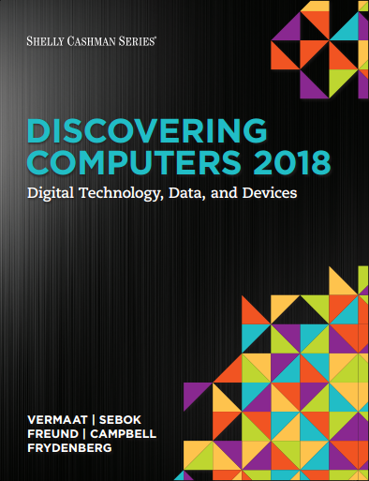
Textbook: M. E. Vermaat, S. L. Sebok, S. M. Freund, J. T. Campbell, and M. Frydenberg, Discovering Computers 2018: Digital Technology, Data, and Devices, Cengage Learning, Boston, MA, 2018.
劉朝棟, 0935286372, 華泰文化
Reference: P. Norton, Peter Norton's Introduction to Computers, 6th Ed., McGraw-Hill, New York, 2006.
Reference: M. M. Mano, Computer Engineering: Hardware Design, Prentice Hall, Englewood Cliffs, NJ, 1988.
Reference: J. G. Brookshear, Computer Science: An Overview, 11th Ed., Addison Wesley, Reading, MA, 2012.
excellent World Wide Web address: to look up computer terminology online http://www.wikipedia.org
excellent World Web address: to search companies, products, and events http://www.google.com, http://www.yahoo.com, http://www.msn.com
Projects: will be assigned every week or every other week (30%)
Examinations: one midterm (30%) and one final (40%)

Slide 3
Chapter 1: Introducing Today’s Technologies: Computers, Devices, and the Web
Chapter 2: Connecting and Communicating Online: The Internet, Websites, and Media
Chapter 3: Computers and Mobile Devices: Evaluating Options for Home and Work
Chapter 4: Programs and Apps: Productivity, Graphics, Security, and Other Tools
Chapter 5: Digital Security, Ethics, and Privacy: Threats, Issues, and Defenses
Chapter 6: Computing Components: Processors, Memory, the Cloud, and More
Notes:
加選(但沒在NTU cool)

Slide 4
Chapter 7: Input and Output: Extending Capabilities of Computers and Mobile Devices
Chapter 8: Digital Storage: Preserving Content Locally and on the Cloud
Chapter 9: Operating Systems: Managing, Coordinating, and Monitoring Resources
Chapter 10: Communicating Digital Content: Wired and Wireless Networks and Devices
Chapter 11: Building Solutions: Database, Systems, and Application Development Tools
Chapter 12: Working in the Enterprise: Systems, Certifications, and Careers

Slide 5
Drop this course, if you don’t agree.
Students will present course material.
I will only present Chapter 1.
Every toddler has to fall to learn to walk.
This is very important training for their research and presentation.
My hearing is weak, so speak loudly unconsciously, hurt vocal cord, and cannot close properly.
Notes:
課程須知 (也是我們傅老師像要告訴大家的話)
那這一堂課呢會由同學們來教其他同學課程內容
我只會講第一章，後面的就由有意願教大家的同學們來做教學。
目前有沒有自願的~沒有的話就會抽籤決定囉~ (有上來報告的同學我們一定會加分，加到你接下來都躺著也能過的那種)
大家上來講也不用害怕講錯還是覺得不好意思，老師都會在旁邊給予指導，這樣你們也對這些容易出錯的知識更加了解
還有一個需要注意的是
老師的聽力比較弱，所以說話有時候會不自覺的比較大聲，
而且聲帶有受傷，沒辦法正常閉合。阿不過正常的對話和授課還是沒有問題的，請各位同學放心~

Slide 6
Drop this course, if you don’t agree.
Don’t complain in teaching feedback survey.
If you agree, praise in teaching feedback.
Notes:
如果您們覺得這門課不好、不滿意這門課的話，歡迎大家退選這門課。
或是立刻跟我講也可以
所以我們不要在學期末的教學回饋調查中寫惡評歐
如果你願意的話，也請在教學回饋中給予讚美。

Slide 7
Please Drop This Tough Course, If Unwilling
為了維持教學品質，我們希望真正有興趣的人才來修， 所以會嚴格點名，三次不到就會當掉。
作業漏交三次就會當掉。
不能吃苦的請儘速退選。

Slide 8
Scan and add all figures, captions, and tables.
Add Review Questions.
Add Homework at end of your PPT
Add topics and explain in detail.
Add jokes.
Design two questions and answers.
Notes:
報告者需要注意的事項
掃描並新增所有圖表、標題和表格。
新增複習題。
在 你的PPT最後面新增回家作業。
添加主題並詳細解釋。
添加笑話。 (笑話比本文重要)
設計兩個問題和答案。

Slide 9
1. (10%) What are the four steps in Information Processing Cycle?
Answer: Input, Processing, Output, Storage.
Notes:
1. (10%) 資訊處理週期的四個步驟是什麼？
答：輸入、處理、輸出、儲存。

Slide 10
I have a dream. Martin Luther King Jr.
ACM: Association for Computing Machinery
ACM International Collegiate Programming Contest
https://uva.onlinejudge.org/
solving 20 problems = 5 points, 50 problems = 10 points
100 problems = 20 points, 200 problems = 30 points, 400 problems = 40 points
All problems with on-line judge = 50 points
Tell me the number of problems solved immediately before final examination
Notes:
我們資訊領域有一個組織叫做ACM，他們每年都會舉辦一次國際大學生程式設計競賽，
阿他們考過的題目我們可以在這裡找到 那我們這堂課有一個加分機制，就是
我們每解決20個問題加學期成績5分
50個問題加10分…像上面列的這樣
如果解決了整個online judge的題目的話就加學期成績50分!!
那解決玩了之後就email跟我說，我們接受加分到期末考當天
以上還有沒有問題~
跨校選課
需要加簽

Slide 11

DISCOVERING COMPUTERS 2018 Digital Technology, Data, and Devices
Module 1
Introducing Today’s Technologies:
Computers, Devices, and the web
© 2018 Cengage版權所有，為課本著作之延伸教材，亦受著作權法之規範保護，僅作為授課教學使用，禁止列印、影印、未經授權重製和公開散佈
Notes:
放笑話時間==
https://youtu.be/paWE-GvDO1c?si=-w3QnIOqbGugVYft&t=287
那接下來就開始我們的第一章

Slide 12
Objectives Overview (1 of 3)
Differentiate among laptops, tablets, desktops, and servers.
Describe the purpose and uses of smartphones, digital cameras, portable and digital media players, e-book readers, wearable devices, and game devices.
Describe the relationship between data and information.
Briefly explain various input options.
Notes:
首先我們先來了解一下這個第一章的主要目的
我們第一章主要就是要讓各位
了解不同種類電腦的用途
以及資料和資訊之間的差異

Slide 13
Objectives Overview (2 of 3)
Differentiate the web from the Internet, and describe the relationship among the web, webpages, websites, and web servers.
Explain the purpose of a browser, a search engine, and an online social network.
Briefly describe digital security risks associated with viruses and other malware, privacy, your health, and the environment.
Differentiate between an operating system and applications.
Notes:
然後了解網際網路、瀏覽器、搜尋引擎之間的運作。
也會稍微提到一些數位安全議題
然後也會提到我們是如何區分作業系統和應用程式。

Slide 14
Objectives Overview (3 of 3)
Differentiate between wired and wireless technologies, and identify reasons individuals and businesses use networks.
Discuss how society uses technology in education, government, finance, retail, entertainment, health care, science, travel, publishing, and manufacturing.
Identify technology used by home users, small/home office users, mobile users, power users, and enterprise users.
Notes:
然後我們也會提到有線和無線技術的區別，還有個人和企業使用網路的原因
最後我們會了解社會如何在不同領域中使用科技。

Slide 15
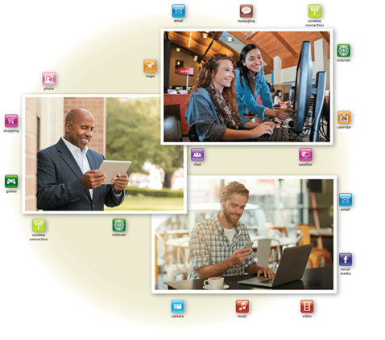
Today’s Technology (1 of 2)
Because technology changes, you must keep up with the changes to remain digitally literate.
Digital literacy involves having a current knowledge and understanding of computers, mobile devices, the web, and related technologies.
Figure 1-1 People use a variety of computers, mobile devices, and apps every day.
Notes:
現在的科技日新月異，我們應該要保持數位素養。
那數位素養就是對於電腦、行動裝置、網路和相關技術的最新知識的認識和理解。

Slide 16
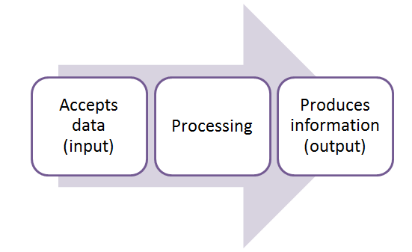
Computers (1 of 5)
A computer is an electronic device, operating under the control of instructions stored in its own memory.
Notes:
那首先我們先來了解甚麼是計算機
計算機是一種電子設備，它是透過儲存在自身記憶體中的指令，來控制它的所有動作
那它執行指令的主要流程 就如這張圖上所示 接收資料(也就是input)，按照指定規則進行處理，最後產生資訊（也就是output）
那透過各種指令我們就可以完成許多動作，像是搜尋資料、製作簡報、撰寫論文等等。

Slide 17
Computers (1 of 5)
Types of personal computers include laptops, tablets, and desktops, with the first two sometimes called mobile computers.
Notes:
那我們最常見的計算機類型就是個人電腦，包括筆記型電腦、平板電腦、桌上型電腦，一次只能讓一個人使用

Slide 18
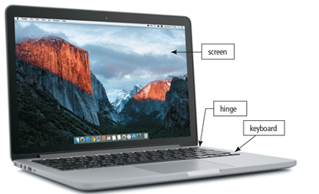
Figure 1-2 A laptop is a widely used type of computer.
Notes:
螢幕、轉軸、鍵盤

Slide 19
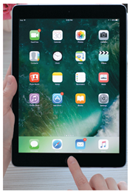
Figure 1-3 A slate tablet.

Slide 20
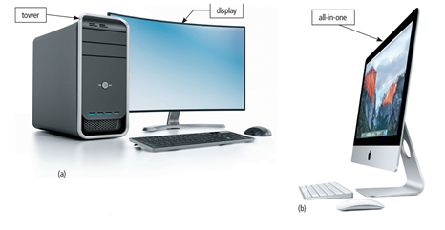
Figure 1-4 Some desktops have a separate tower; all-in-ones do not.
Notes:
這些你們應該都知道，我就不仔細介紹了

Slide 21
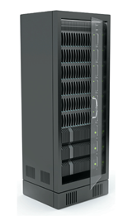
Figure 1-5 A server provides services to other computers or devices on a network.
Notes:
那除了個人電腦之外，還有伺服器
它比起個人電腦，屬於更高級的計算機
專用於向網路上的其他電腦裝置提供一項或多項服務，包括儲存內容 以及 控制網路上的硬體、軟體或是其他資源的存取。
通常我們可以透過網路來將電腦無線連接在一起。
阿投影片上的這個就是伺服器通常的樣子

Slide 22
Mobile and Game Devices
Smartphone
Digital camera
Portable and digital media player
E-book reader
Wearable device
Game device
Notes:
接著還有其他計算機的類型 包括行動裝置和遊戲裝置
行動裝置常見的有包括我們平常在用的手機、相機、隨身聽、電子書還有像apple watch這類的穿戴式裝置
而遊戲裝置則是像switch或是Wii等等的東西

Slide 23
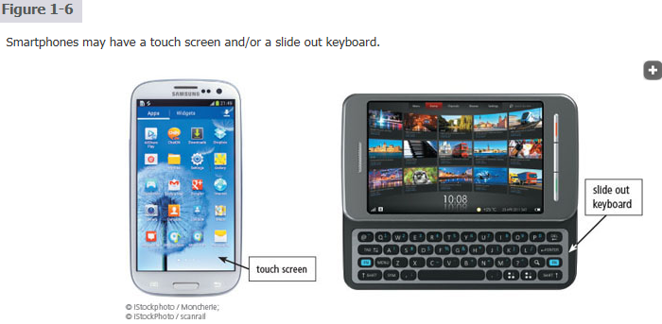

Slide 24
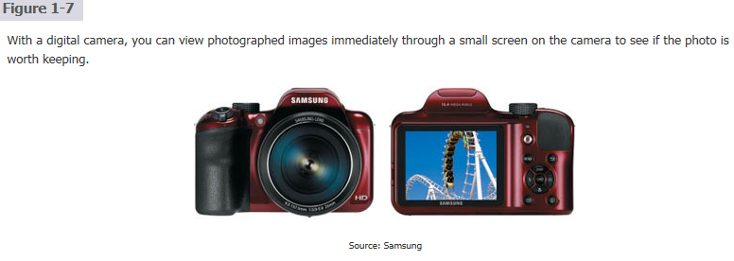

Slide 25
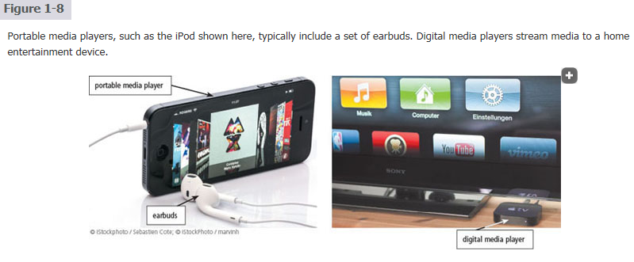

Slide 26
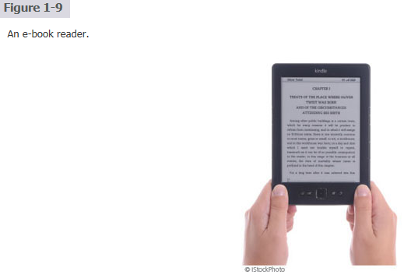

Slide 27
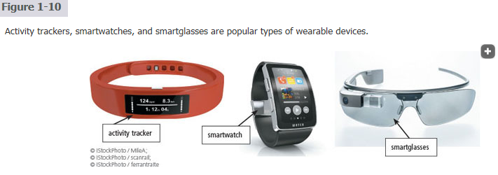

Slide 28
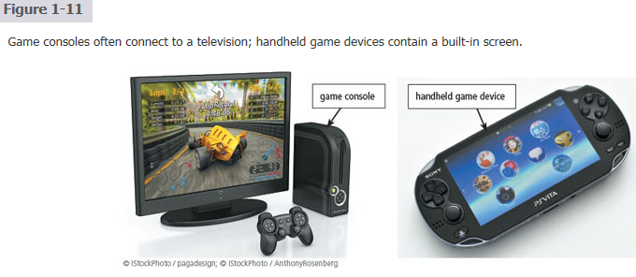

Slide 29
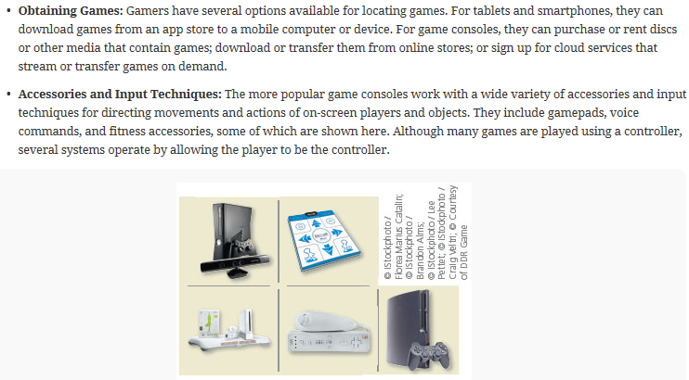
Notes:
在課本的這一小節的最後面有一篇文章是在講關於遊戲與數位家庭的發展

Slide 30
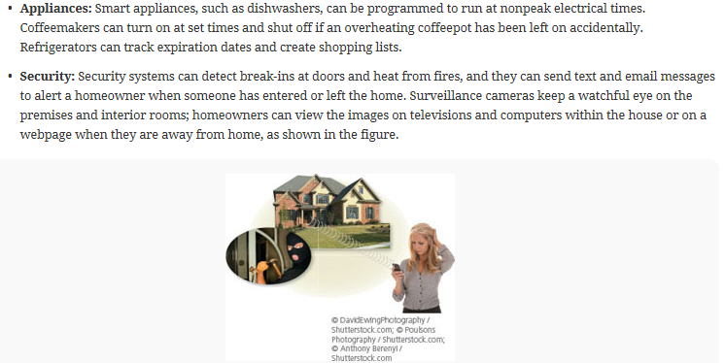

Slide 31
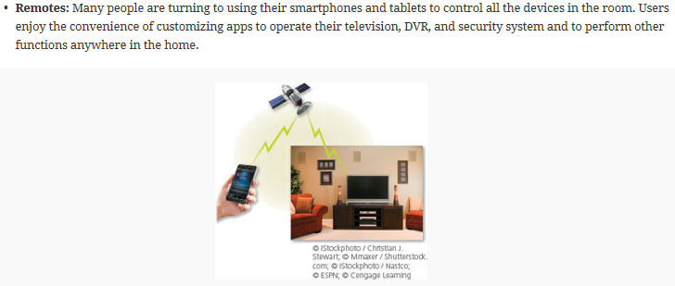
DVR: Digital Video Recording
ESPN: Entertainment and Sports Programming Network

Slide 32
Data and Information (1 of 14)
Computers process data (input) into information (output) and often store the data and resulting information for future use.
Data is a collection of unprocessed items, which can include text, numbers, images, audio, and video.
Information conveys meaning to users.
Notes:
放笑話時間==
https://www.youtube.com/watch?v=paWE-GvDO1c&t=593s
那接下來 我們來講資料以及資訊的關係
資訊就是經過處理的資料，例如我們拿到各位的期中考的成績的時候 這些成績 就是所謂的資料，
我們如果要透過這些成績知道你們的學習狀況的話 我們可能就會算出各位的成績的平均、標準差還有中位數等等的數值，那這些數值就可以被稱為資料

Slide 33
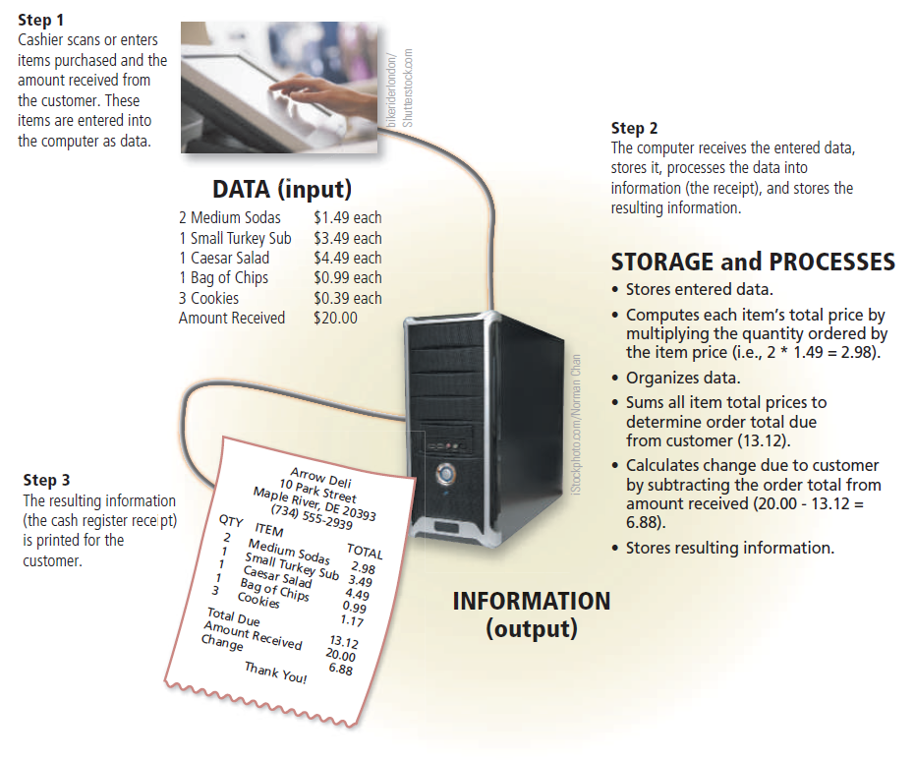
Figure 1-12 A computer processes data into information. In this simplified example, the item ordered, item price, quantity ordered, and amount received all represent data (input). The computer processes the data to produce the cash register receipt (information, or output).
Notes:
那這個就是計算機將資料轉換成資訊輸出的是意圖
一個計算機通常會包含以下四種硬體元件
輸入元件、輸出元件、儲存元件以及處理元件

Slide 34
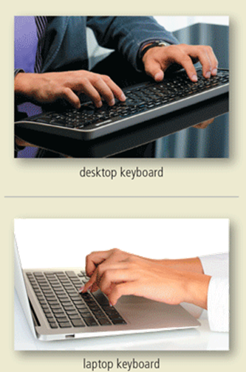
Data and Information (2 of 14)
A keyboard contains keys you press to enter data and instructions into a computer or mobile device
Notes:
首先我們常見的可以輸入資料的硬體元件，也就是輸入裝置依照功能可以被分為輸入文字、影像、聲音還有點擊等等的輸入。
其中，輸入文字的輸入裝置，除了像這樣按鍵式的鍵盤之外

Slide 35
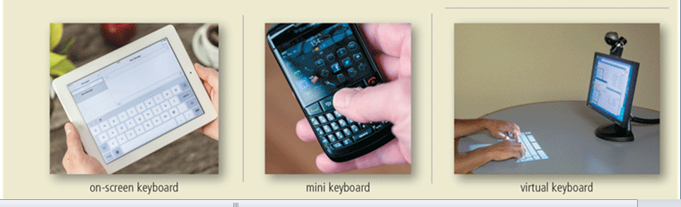
Data and Information (3 of 14)
Figure 1-13 Users have a variety of options for entering typed text.
Notes:
還有像這個圖一和圖三這樣的觸控式螢幕和虛擬鍵盤，都屬於用來輸入文字的裝置

Slide 36
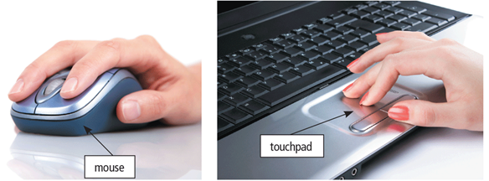
Data and Information (4 of 14)
A pointing device is an input device that allows a user to control a small symbol on a screen, called the pointer.
Some mobile devices and computers enable you to speak data instructions using voice input and to capture live full-motion images using video input.
Figure 1-14 A mouse and a touchpad.
Notes:
而輸入點擊的裝置，則包括滑鼠和觸控板

Slide 37
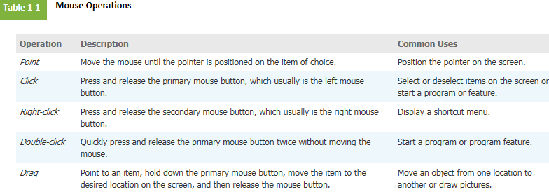

Slide 38
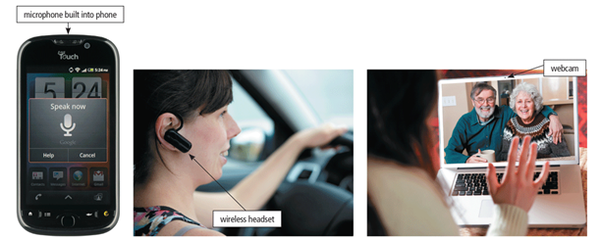
Data and Information (5 of 14)
Figure 1-15 You can speak instructions into a microphone or wireless headset and capture live video on a webcam for a video call.
Notes:
另外，還有用來輸入聲音和影像的裝置，像是手機的和無線耳機上的微型麥克風，以及筆電上的webcam

Slide 39
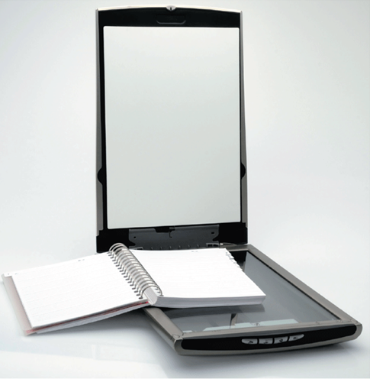
Data and Information (6 of 14)
A scanner is a light-sensing input device that converts printed text and images into a form the computer can process.
Figure 1-16 A Scanner.
Notes:
還有掃描器，也是一種常見的輸入裝置，可以用來輸入文件和影像

Slide 40
Data and Information (7 of 14)
An output device is any hardware component that conveys information from a computer or mobile device to one or more people.
A printer is an output device that produces text and graphics on a physical medium, such as paper or other material.
A 3-D printer can print solid objects, such as clothing, prosthetics, eyewear, implants, toys, parts, prototypes, and more.
Notes:
接著是輸出裝置，也就是將資訊從電腦或行動裝置傳遞給使用者的硬體元件。

Slide 41
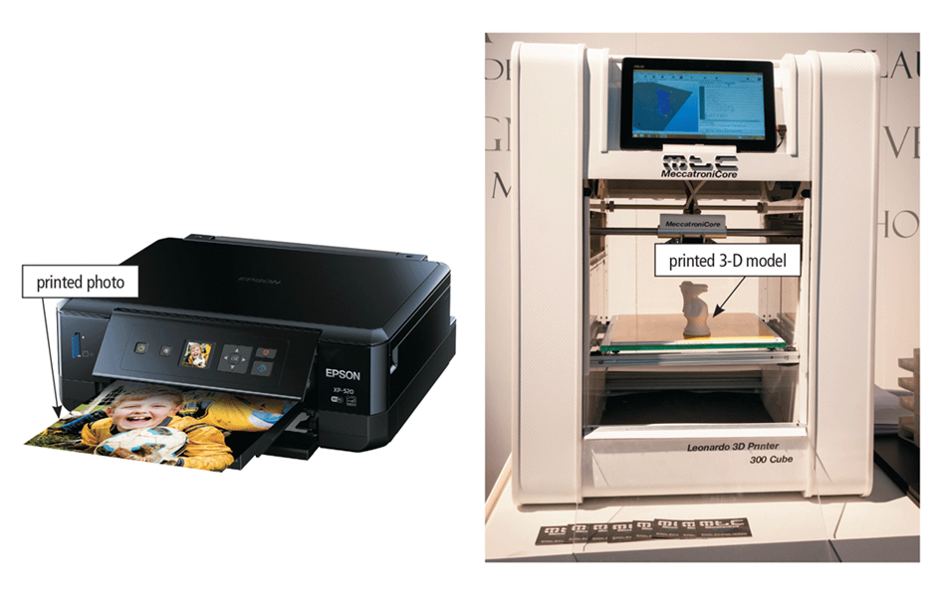
Figure 1-17 A printer can produce a variety of printed output including photos and 3-D solid objects.
Notes:
包括印表機、3D列印機

Slide 42
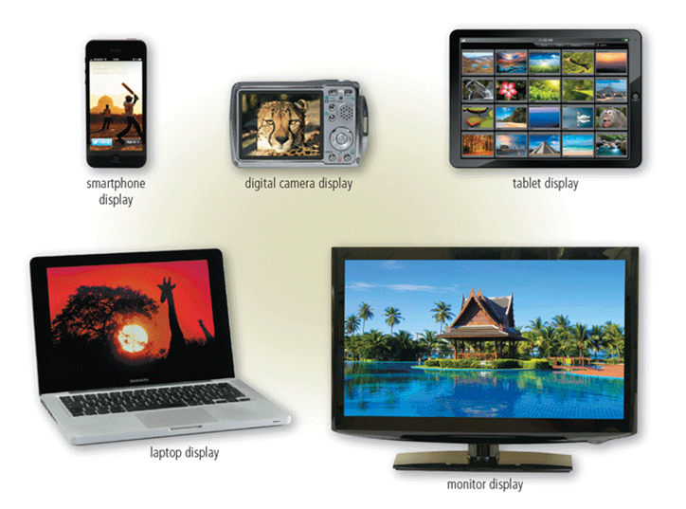
A display is an output device that visually conveys text, graphics, and video information
Figure 1-18 Displays vary depending on the computer or mobile device.
Notes:
以及各式各樣的螢幕

Slide 43
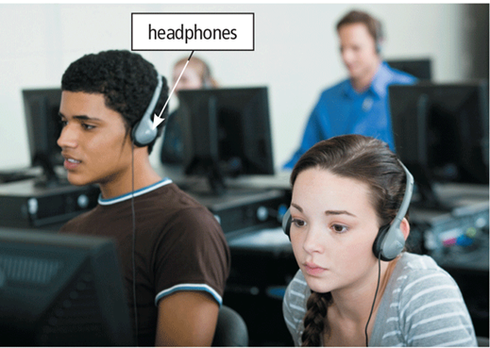
Speakers allow you to hear audio such as music, voice, and other sounds.
Earbuds
Headphones
Figure 1-19 In a crowded environment where speakers are not practical, users can wear headphones to hear music, voice, and other audio.
Notes:
或是耳機，都屬於輸出裝置，可以顯示影像、聲音等等的資訊給使用者

Slide 44
Data and Information (11 of 14)
Memory consists of electronic components that store instructions waiting to be executed and the data needed by those instructions.
A computer keeps data, instructions, and information on storage media.
A storage device records (writes) and/or retrieves (reads) items to and from storage media.
Notes:
接著是記憶體和儲存裝置的介紹，
記憶體是用來暫時儲存等待CPU執行的指令及其所需資料的電子元件，大多屬於暫時性，電腦關機後內容會消失。 儲存裝置則是用來長期保存資料和程式的設備，會將資料讀取（read）或寫入（write）到各種儲存媒介，如硬碟、SSD、USB、記憶卡和光碟等。
那這邊有一個比較需要特別注意的地方是
storage device 儲存設備 指的是光碟機或是讀卡機這種用來讀取或寫入的裝置
storage media 儲存媒介 指的是光碟片、隨身碟或是SSD這種用來實際存放資料的載體

Slide 45
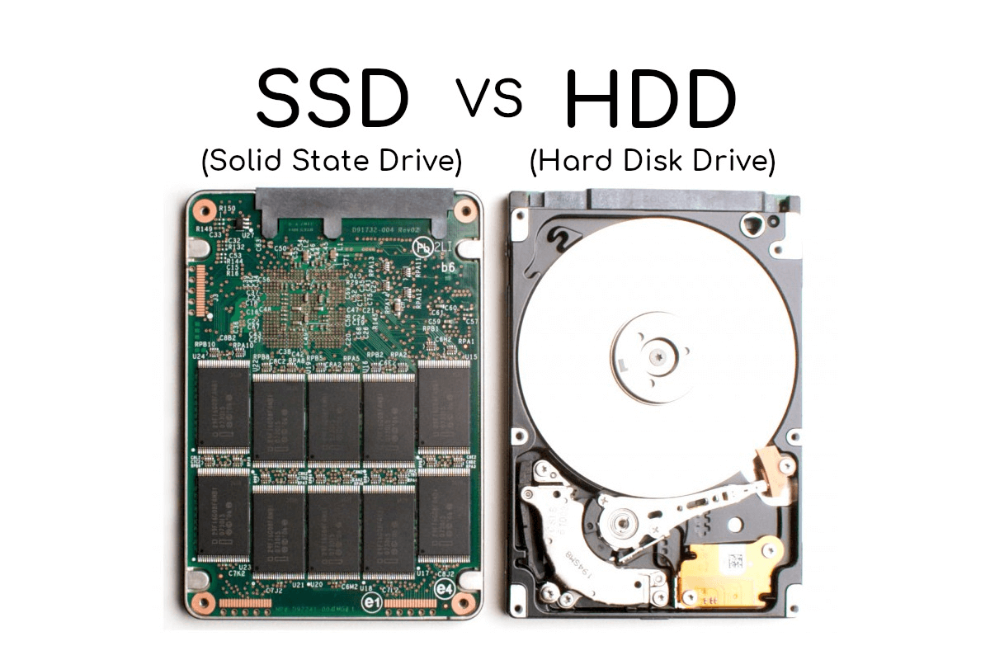
Data and Information (12 of 14)
Notes:
那接下來就是一些常見的儲存裝置
首先是硬碟(HDD) 是一個透過磁性粒子來儲存資料的儲存設備，使用旋轉磁碟和讀寫頭來讀取和寫入資料。
那右邊這個則是 固態硬碟 (SSD)
他是一種使用積體電路元件儲存資料的儲存設備。
他的工作原理就是將資料儲存在快閃記憶體單元中，使用電荷來表示二進位資料。
那因為SSD使用的是快閃記憶體，不會像HDD這樣有機械運動的需求
所以速度比較快，也筆記較不會發熱
所以如果你是想要仔入速度快，或是多工處理就可以選擇SSD
如果需要經濟實惠且儲存量很大的話則可以選擇HDD

Slide 46
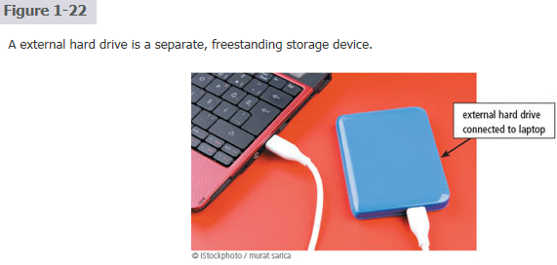
Notes:
那接著這個是外接式硬碟
它的內部結構和內建的HDD和SSD一樣
但比起剛剛那兩個用來裝在電腦裡的
這個就可以隨身帶著走，

Slide 47
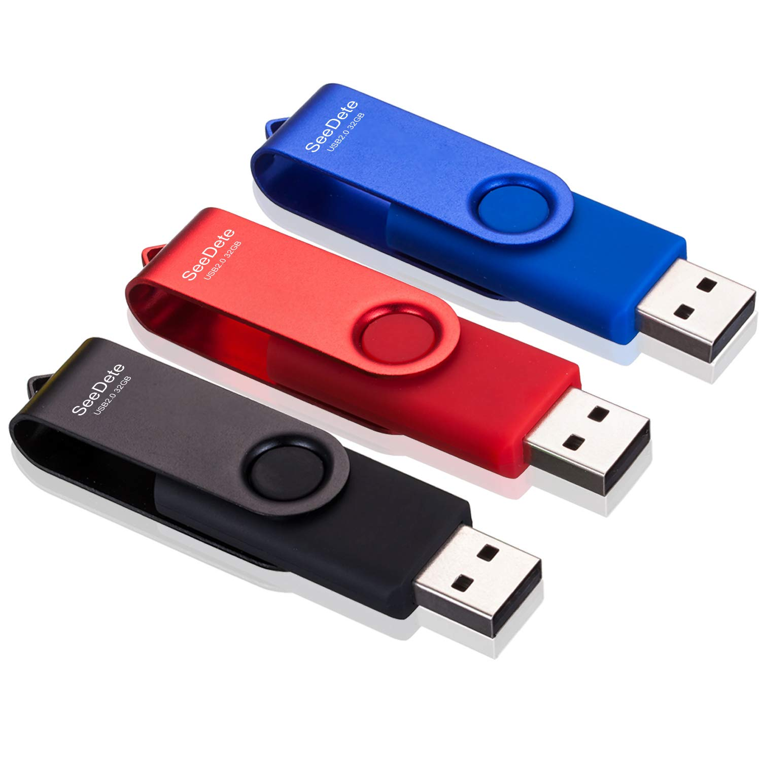
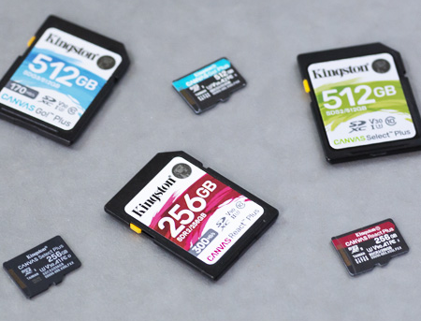
Data and Information (13 of 14)
USB Flash Drive
Memory Card
Notes:
那接著左邊這個是USB隨身碟，它是一種便攜式快閃記憶體 儲存裝置，可以直接插在電腦或手機的USB插槽上。
右邊這個是記憶卡，也是可攜式的快閃記憶體，，常見於相機、手機和平板。記憶卡需要插入專用的插槽或讀卡機，才能在電腦或印表機之間傳輸像數位照片這類資料。
不用講: MicroSD 記憶卡是 SD 記憶卡的較小版本，兩者之間的最大差異在於外形尺寸。
(https://www.kingston.com/tw/blog/personal-storage/microsd-sd-memory-card-guide)

Slide 48
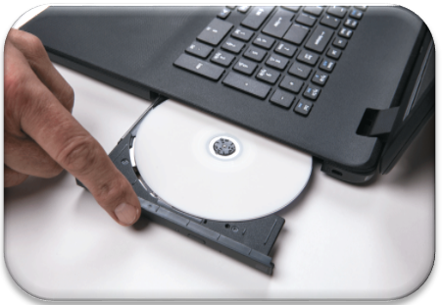
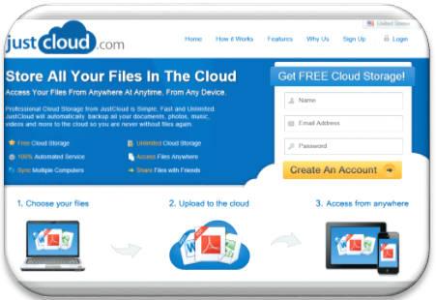
Data and Information (14 of 14)
Optical Disc
Cloud Storage
Notes:
接著是光碟和雲端儲存裝置
左邊的 光碟是一種儲存媒介，它是透過雷射來讀取和寫入
可以被分成CD（光碟）和 DVD（數位多功能光碟）兩種
那右邊的雲端儲存是為電腦使用者提供的遠端儲存的雲端服務。Google Drive、Microsoft OneDrive、AWS 等等都是常見的雲端儲存服務。

Slide 49
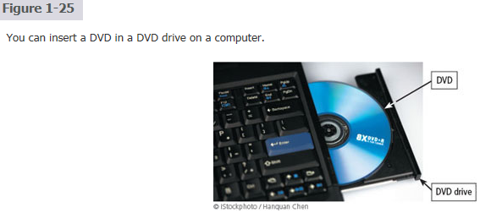
DVD: Digital Versatile Disk
DVD: Digital Video Disk
R: Recordable

Slide 50
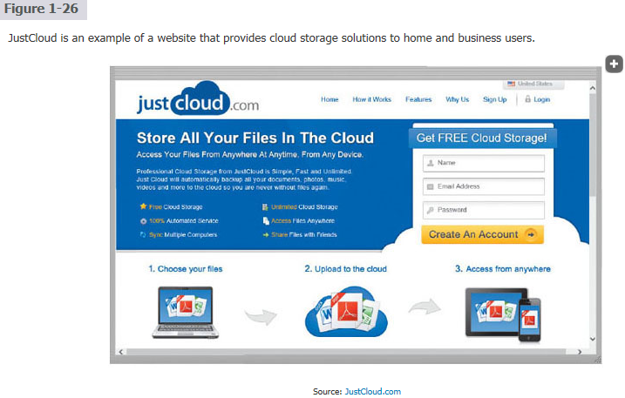

Slide 51
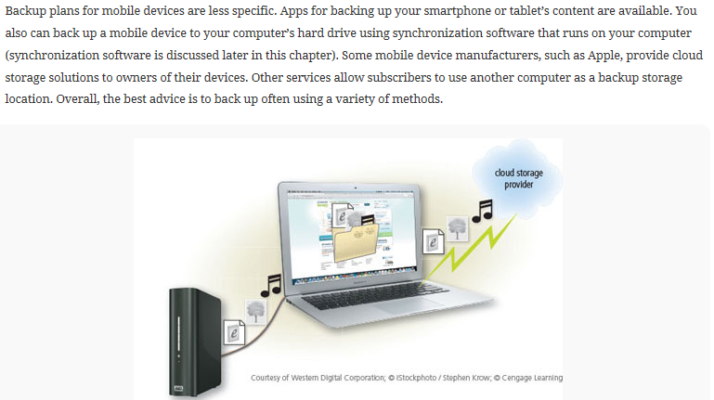

Slide 52
The Web (3 of 8)
The World Wide Web (or web, for short) is a global library of information available to anyone connected to the Internet.
The web consists of a worldwide collection of electronic documents, each of which is called a webpage.
A website is a collection of related webpages.
A web server is a computer that delivers requested webpages to your computer or mobile device.
Notes:
放笑話時間==
https://www.youtube.com/watch?v=VhWMTEH9VJc
接下來講下個章節
World Wide Web 全球資訊網，簡稱 Web
是一個提供任何人透過網際網路連接的一個全球資料庫
它是由很多來自世界各地的電子文檔組成，每個文檔都稱為一個網頁。
而網站呢? 則是相關的網頁的集合。
網頁伺服器是一台計算機，它負責將我們要求的網頁傳送到我們的電腦或手機中。

Slide 53
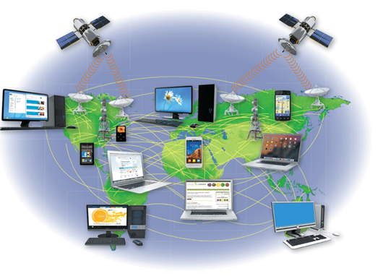
The Web (1 of 8)
The Internet is a worldwide collection of computer networks that connects millions of businesses, government agencies, educational institutions, and individual.
Figure 1-27 The Internet is the largest computer network, connecting millions of computers and devices around the world.
Notes:
而網際網路則是電腦網路和電腦網路之間串聯所形成的龐大的網路系統
包括企業及政府機構、教育機構或是個人的電腦網路，通常是透過無線網路或光纖網路等技術連接在一起的。

Slide 54
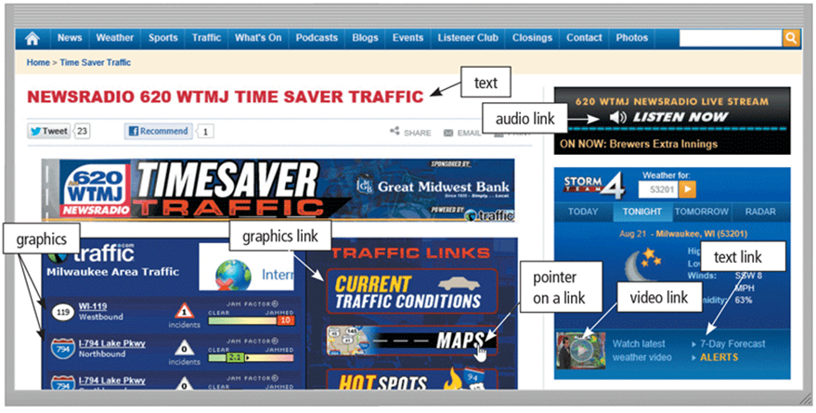
Figure 1-28 Webpages, such as the one shown here, can display text, graphics, audio, and video on a computer or mobile device. Pointing to a link on the screen typically changes the shape of the pointer to a small hand with a pointing index finger.
Notes:
那這個就是我們常看到的網頁，可以再裡面放入文字、影像、連結、音訊或影片等等。

Slide 55
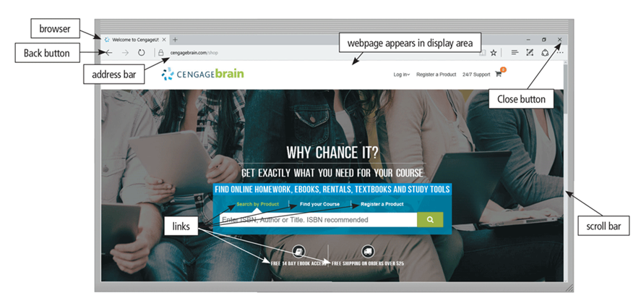
The Web (5 of 8)
A browser is software that enables users with an Internet connection to access and view webpages on a computer or mobile device
Notes:
那我們要存取或檢視這個網頁的話
則需要透過一種軟體，稱為browser瀏覽器，才能在電腦或手機中開啟網頁，常見的像是chrome或是safari等等

Slide 56
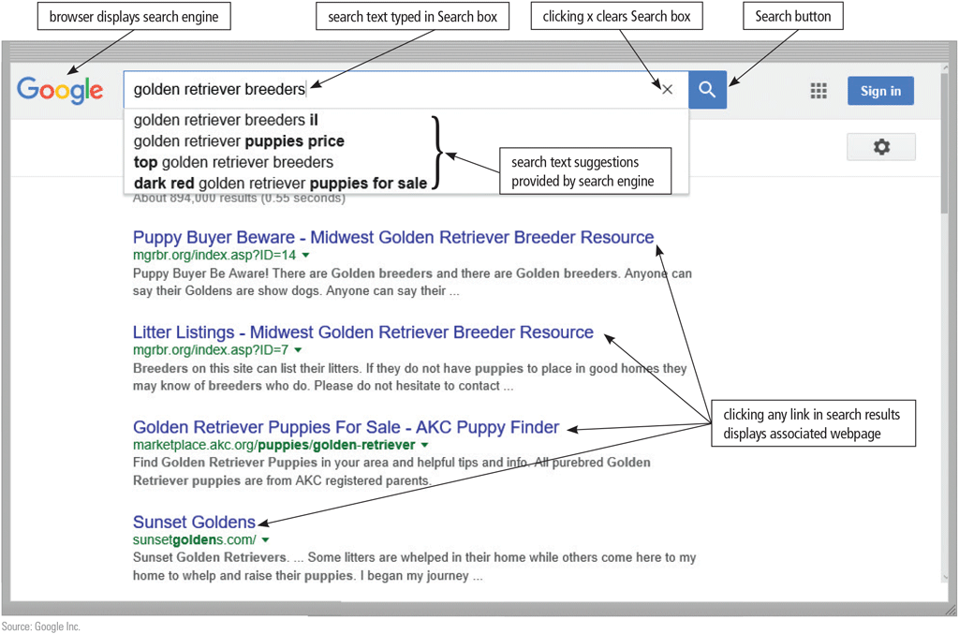
The Web (6 of 8)
A search engine is software that finds websites, webpages, images, videos, news, maps, and other information related to a specific topic
Notes:
那搜尋引擎則是一種尋找與特定主題相關的網站、網頁、圖片、影片、新聞、地圖和其他資訊的軟體

Slide 57
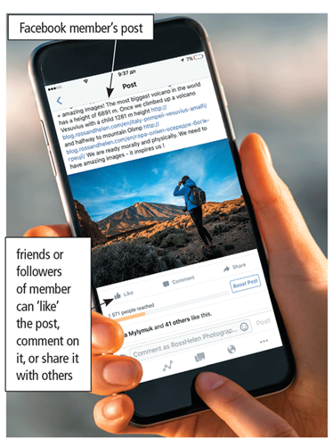
The Web (7 of 8)
An online social network, also called a social networking site, is a website that encourages members in its online community to share their interests, ideas, stories, photos, music, and videos with other registered users.
Figure 1-29 When Facebook users share, comment on, or “like” a post, the post appears on their own personal Facebook pages.
Notes:
最後，社交網路 social network，應該大家都知道，就是像 facebook、Instagram、Threads等等，這些可以分享興趣、分享故事、或是日常照片、影片的網站。

Slide 58
Digital Safety and Security (1 of 2)
It is important that users protect their computers and mobile devices
Viruses and Other Malware
Privacy
Health Concerns
Notes:
接下來下一節要講的是數位安全與隱私
現在因為科技發達，大家都很依賴電腦，但是對於自己的個人隱私和健康安全，應該要有一定的防範意識
首先，就是惡意軟體的攻擊，常見的像是病毒、木馬程式或是一些廣告軟體，他們會在我們不經意的情況下入侵我們的電腦，
所以我們要特別注意，定期更新你們的防毒軟體、不要隨便點擊或下載來路不明檔案和連結。
第二個重點就是隱私。現代人的醫療紀錄、信用卡資料或是個人資訊都被儲存在電腦裡。
我們應該要小心保護自己的帳號密碼，也避免在網路上公開敏感資料，才能防止身分被盜用。
接著是健康問題。因為長時間使用電腦或手機容易造成手腕、脖子和眼睛的傷害，所以保持適度的休息很重要，
尤其我們現在身為大學生 動不動就要做報告、寫程式，一定要多注意電腦和手機的使用時間

Slide 59
Digital Safety and Security (2 of 2)
Green computing involves reducing the electricity consumed and environmental waste generated when using a computer
Strategies include:
Recycling
Using energy efficient hardware and energy saving features
Regulating manufacturing processes
Extending the life of computers
Immediately donating or properly disposing of replaced computers
Notes:
那最後是環境議題
現在很多人都提倡綠色運算
隨著AI和雲端運算越來越普及，全球數據中心的用電量也不斷攀升。
像是大家每天用的ChatGPT、抖音、YouTube等服務，其實背後都需要大量電腦和伺服器持續運作。
這讓「綠色運算」變得越來越重要。
而我們自己也能從日常做起，比如選擇高效節能標章的電腦、手機，定期更新軟體讓裝置效率更高。
家裡不用的舊手機、舊筆電，也不要隨便丟掉，可以拿去便利商店、回收點回收，減少有害物質流入環境。

Slide 60
Programs and Apps (1 of 6)
Software, also called a program, tells the computer what tasks to perform and how to perform them
system software
Operating Systems
application software
Notes:
接著進入最後一個章節 軟體與應用程式
軟體，又稱為程式，負責告訴電腦應該執行那些任務以及怎麼執行
那軟體又可以被分成兩種
一個是系統軟體
一個是應用軟體
那作業系統就是一種系統軟體，用來協調電腦或手機的硬體間的運作

Slide 61
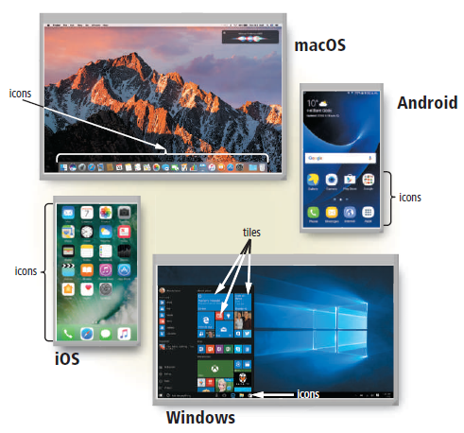
Figure 1-30 Shown here are the macOS and Windows operating systems for laptops and desktops and the Android and iOS operating systems for smartphones. You interact with these operating system interfaces by clicking or tapping their icons or tiles.
Notes:
那常見的就是MacOS以及Windows
手機的話則還有Android 和 iOS

Slide 62



Programs and Apps (3 of 6)
Applications
Notes:
那應用軟體呢
則是用於提高使用者工作效率或協助使用者完成各項任務的程式
像是常見的Word、PowerPoint以及剛剛提到的瀏覽器和社交軟體等等

Slide 63
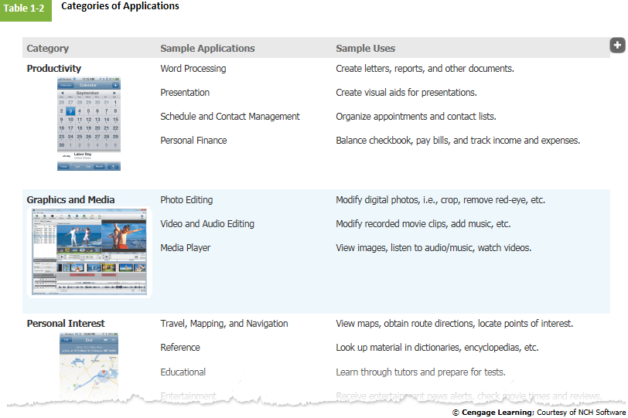

Slide 64
Programs and Apps (4 of 6)
Installing a program is the process of setting up the program to work with a computer or mobile device, printer, and/or other hardware
Once installed, you can run a program so that you can interact with it
You interact with a program through its user interface
Notes:
接著就是一些名詞解釋
程式安裝就是指 設定程式使其與電腦或是其他硬體相容的過程。

Slide 65
Programs and Apps (5 of 6)
A software developer, sometimes called a developer or programmer, is someone who develops programs and apps or writes the instructions that direct the computer or mobile device to process data into information
Notes:
軟體開發人員，就是開發程式和應用軟體，又或編寫指令的人

Slide 66
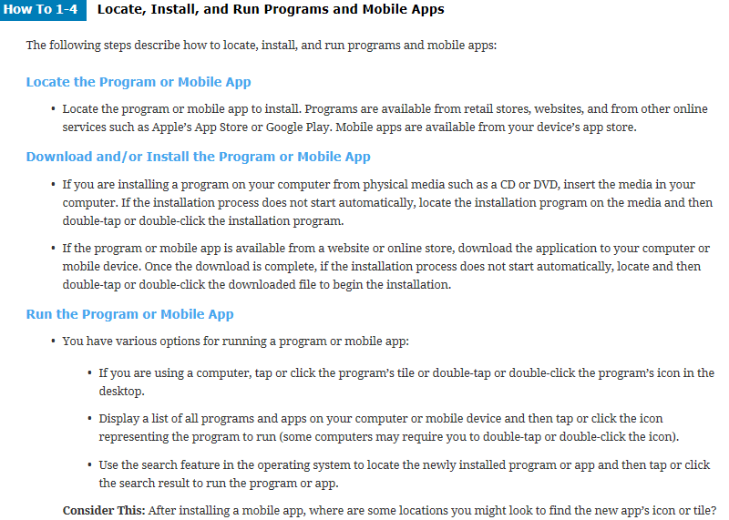
CD: Compact Disk
DVD: Digital Versatile Disk

Slide 67
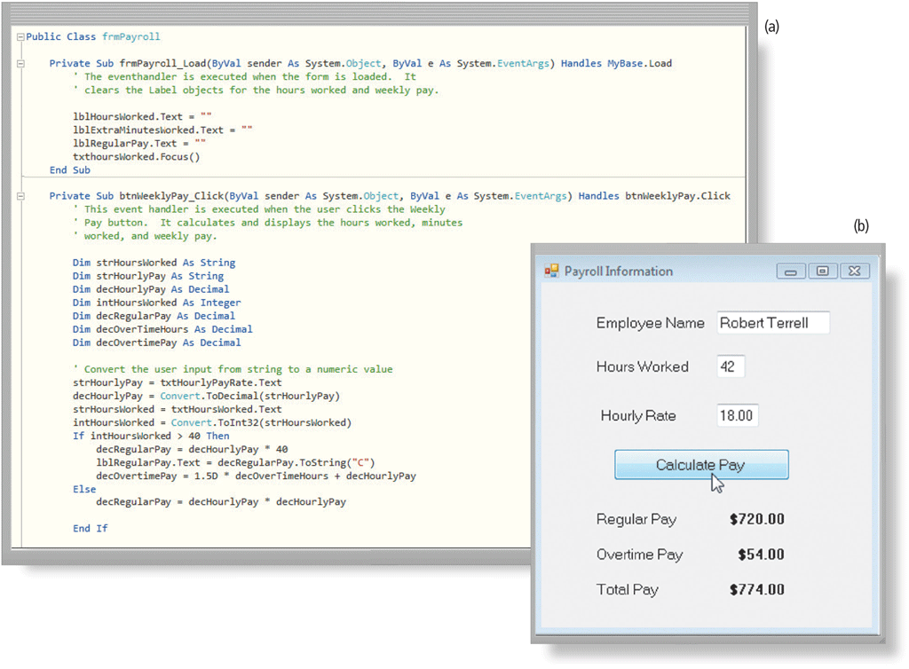
Figure 1-31 A software developer writes instructions using Visual Basic (a) to create Payroll Information window shown here (b).

Slide 68
Communications and Networks (1 of 7)
In the course of a day, it is likely you use, or use information generated by, one or more of these communications technologies
Chat rooms
Email
Fax
FTP
GPS
Notes:
跳過

Slide 69
Communications and Networks (2 of 8)
Instant messaging
Internet
Newsgroups
RSS
Videoconference
Voice mail
VoIP

Slide 70
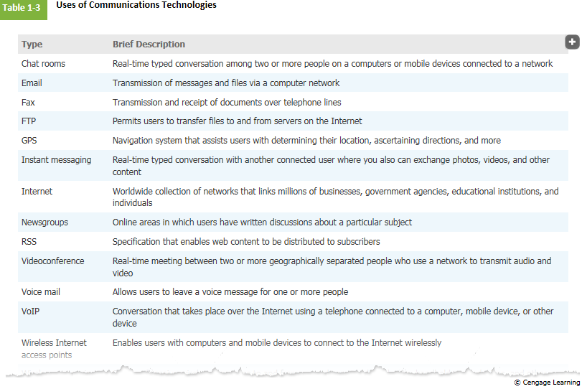

Slide 71
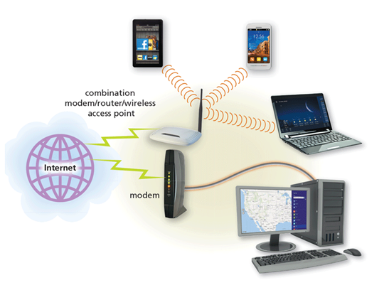
Communications and Networks (3 of 8)
A communications device is hardware capable of transferring items from computers and devices to transmission media and vice versa
Figure 1-32 Modems, wireless access, and routers are examples of communications devices that enable communications between computers/ mobile devices and the Internet. Notice that some computers and devices communicate via wires, and others communicate wirelessly.
Notes:
通訊設備是一種能夠讓資料在不同電腦或設備之間傳遞的硬體
數據機、無線基地台和路由器都是通訊設備的例子，它們讓電腦或行動裝置能夠與網際網路進行通訊
那通訊的方法則可以分成有線的和無線的

Slide 72
Communications and Networks (5 of 8)
Examples of wireless communications technologies include:
Wi-Fi
Bluetooth
Cellular radio
Notes:
其中無線的又包括Wifi、藍芽還有無線電波等等

Slide 73
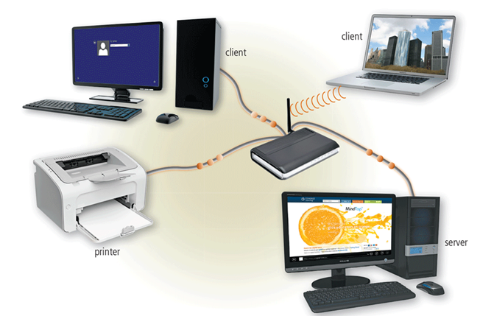
A network is a collection of computers and devices connected together, often wirelessly, via communications devices and transmission media
Figure 1-33 A server manages the resources on a network, and clients access the resources on the server. This network enables three separate computers to share the same printer, one wirelessly.
Notes:
那像圖片這樣透過通訊設備和傳輸媒體連接在一起的電腦和設備 會形成一個網路
而網路允許電腦共享資源，例如硬體、軟體、資料和資訊，可以節省許多時間和金錢，也可以方便管理和控制。
所以現在有許多家庭、以及大部分的企業和學校都會將他們的電腦和設備連網，使成員能夠更方便地進行溝通與協作。
總而言之，網路已經成為現代生活不可或缺的一部分，不僅節省成本，也讓我們的生活與工作更加高效與智慧。

Slide 74
Communications and Networks (7 of 8)
Home Networks
Connect to the Internet
Share a single high-speed Internet connection
Access photos, music, videos, and other content
Share devices
Play multiplayer games
Connect game consoles to the Internet
Subscribe to and use VoIP
Interact with other devices in a smart home
Notes:
那如果這個設備

Slide 75
Communications and Networks (8 of 8)
Business Networks
Facilitate communications
Share hardware
Share data, information, and software
Notes:
Table 2.2 Sample Techniques for Use with Process of Change

Slide 76
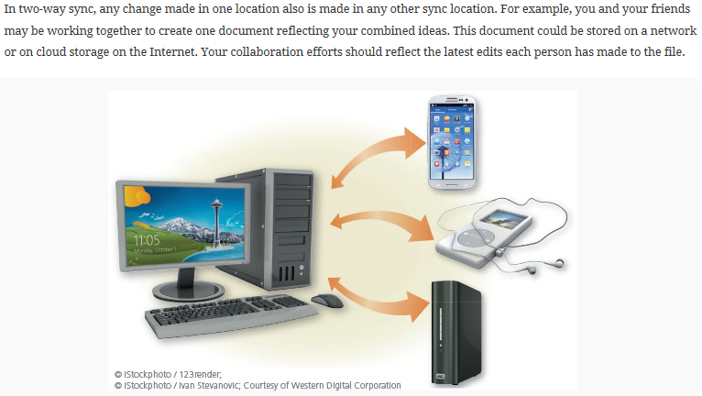

Slide 77
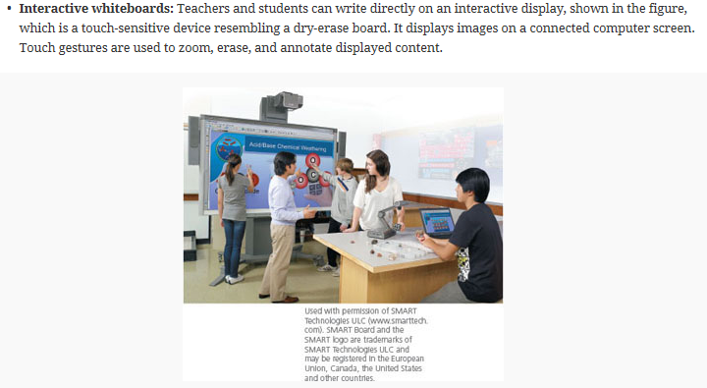

Slide 78
Technology Uses
Education
Government
Finance
Retail
Entertainment
Health Care
Science
Travel
Publishing
Manufacturing
Notes:
那後面是一些科技在不同領域的應用，你們有在關注資訊科技相關的新聞應該就不陌生，
或是可以回去看一下課本，那我在這邊就不贅述了。

Slide 79


Technology Users (1 of 3)
Home User
Small/Home Office User

Slide 80

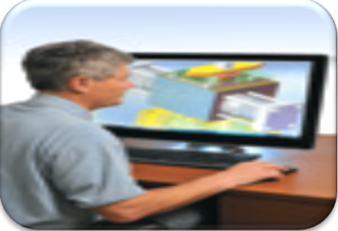
Technology Users (2 of 3)
Mobile User
Power User

Slide 81

Technology Users (3 of 3)
Enterprise Use

Slide 82
Summary
Basic computer concepts
Various methods for input, output, memory, and storage
The Internet
Digital security and safety risks and precautions
Uses of technology applications in society

Slide 83
Project due Sep. 16, 2024
Open your personal computer at home and list the hardware specification as detailed as possible, including the manufacturer, product type, and serial number. List every software installed on your personal computer.
For example:
PC: 宏碁Acer Predator PO3 電競電腦 (PO3-600 i7-8700 電競機 )
CPU: Intel Core i7-8700
RAM: 8G*2 DDR4
GPU: NVIDIA GeForce GTX1080-8GB
Hard Drive: 1TB SATA3 7200RPM+256G SSD(M.2)
Optical Disk Drive: DVDWriter / 500W
monitor: ACER KG251Q 電競螢幕 KG251Q
power supply: 550W
Notes:
那這邊有一個回家作業，就是:
打開家中的個人電腦，盡可能詳細列出硬體規格，包括製造商、產品類型和序號。列出個人電腦上安裝的所有軟體。

Slide 84
keyboard: 電競專用USB Mouse/ KB
speakers: 羅技 Logitech Z150 多媒體音箱喇叭-黑 980-000868
anti-virus software: Norton AntiVirus Plus
anti-virus software: Trend Micro PC-cillin AntiVirus + Security
OS: Microsoft Windows 10
productivity software: Microsoft Office 365
Net Nanny: pornography prevention software
…

